Slide 1

More on ArrayLists
(based on Ch. 4, Objects First with Java - A Practical Introduction using BlueJ, © David J. Barnes, Michael Kölling)
Produced by:
Dr. Siobhán Drohan
Ms. Mairéad Meagher
Ms Siobhan Roche
Department of Computing and Mathematics
http://www.setu.ie/

Slide 2
Topic list
Grouping Objects
Developing a basic personal notebook project using Collections e.g. ArrayList
Indexing within Collections
Retrieval and removal of objects
Generic classes e.g. ArrayList
Iteration
Using the for loop
Using the while loop
Using the for each loop
ShopV3.0 – use an ArrayList of Products instead of an array.

Slide 3
RECAP: Shop V2.0
Driver
v2
Store
Product
Product class stores details of a product’s name, code, unit cost and whether it is in the current product line or not.

Slide 4
RECAP: Shop V2.0
Driver
v2
v2
Store
Product
Store class maintains a collection of Products i.e. a primitive array of Products; store.products[]

Slide 5
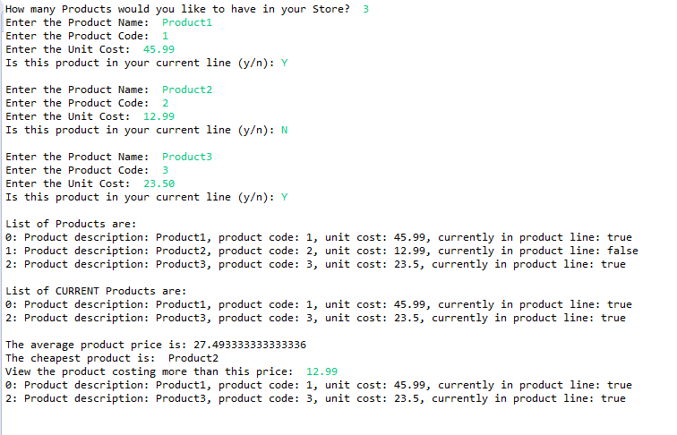
RECAP: Shop V2.0
Driver
v2
v2
Store
Product
Driver allows the user to decide how many product details they want to store, then it stores the product details and prints them out.

Slide 6
RECAP: Shop V2.1
Driver
v2
v2
Store
Product
Driver allows the user to decide how many product details they want to store, then it stores the product details and prints them out.
AND also provides methods operating on the array

Slide 7
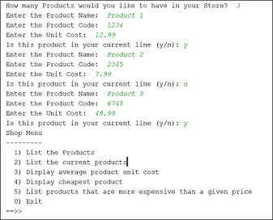
RECAP: Shop V2.2
Driver
v2
v2
Store
Product
Driver allows the user to decide how many product details they want to store, then it stores the product details and prints them out.
AND also provides methods operating on the array
AND provides a console menu system.

Slide 8
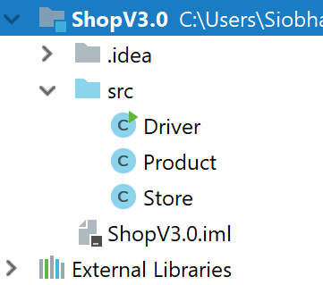
Shop V3.0
v3
GOAL: to keep all the functionality of V2.2 but use an ArrayList of Products
instead of an array.

Slide 9
Shop V3.0 – changes to classes (refactoring)
Driver
Store
Product
Refactor:
any changes to the Store “interface” are reflected in this class
Refactor: to an ArrayList of Product from storing Products in an array
No changes

Slide 10
Product
No changes

Slide 11
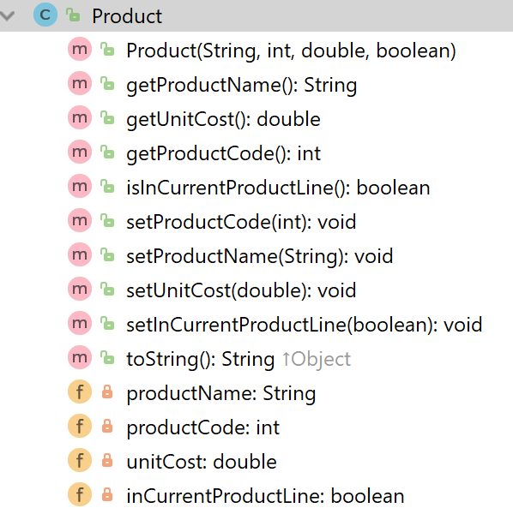
Product
Constructor
getters
setters
toString
fields

Slide 12
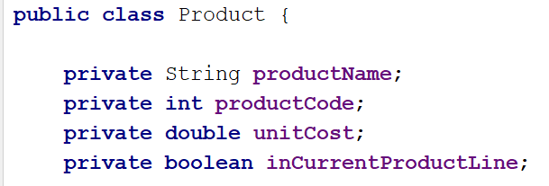
Product
Our Product class contains four fields - instance variables

Slide 13
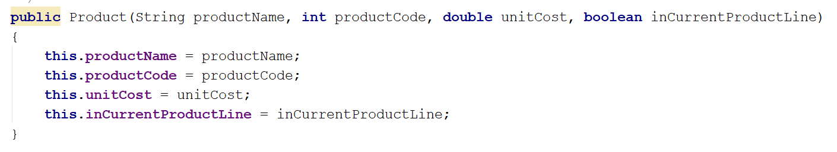
The constructor uses the data passed in the four parameters
to update the instance fields.
Product
Note : we are omitting validation to simplify the example
Name Overloading using keyword this.

Slide 14
Product
The class has getters for each instance field.
public String getProductName(){ return productName; } public double getUnitCost(){ return unitCost; } public int getProductCode() { return productCode; } public boolean isInCurrentProductLine() { return inCurrentProductLine; }

Slide 15
Product
The class has setters for each instance field.
public void setProductCode(int productCode) { this.productCode = productCode; } public void setProductName(String productName) { this.productName = productName; } public void setUnitCost(double unitCost) { this.unitCost = unitCost; } public void setInCurrentProductLine(boolean inCurrentProductLine) { this.inCurrentProductLine = inCurrentProductLine; }
Note : Again, we are omitting validation to simplify the example

Slide 16
The class has a toString method
to return a String
containing a user-friendly representation of the object state.
Product
public String toString() { return "Product description: " + productName + ", product code: " + productCode + ", unit cost: " + unitCost + ", currently in product line: " + inCurrentProductLine; }
We will call this method from the Store class that we will construct over the next few slides.

Slide 17
Store
Refactor to an ArrayList of Product from storing Products in an array

Slide 18
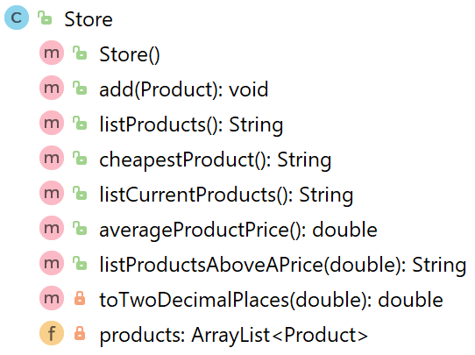
Store
Constructor
methods
1 field

Slide 19
Fields
Store
The Store class now has just one field called products
an ArrayList of Product.

Slide 20
Declaring an ArrayList of Product
Store
importing the ArrayList class so we can use it.
import java.util.ArrayList;
public class Store
{
private ArrayList<Product> products;
// constructor
public Store()
{
products = new ArrayList<Product> ();
}
}

Slide 21
Declaring an ArrayList of Product
Store
importing the ArrayList class so we can use it.
import java.util.ArrayList;
public class Store
{
private ArrayList<Product> products;
// constructor
public Store()
{
products = new ArrayList<Product> ();
}
}
declaring an ArrayList of Product as a private instance variable.
calling the constructor of the ArrayList class to build the ArrayList object.

Slide 22
Methods (1)
Store
These methods work on the ArrayList to:
add Products
print out the contents
print out the cheapest product

Slide 23
Add a product object to an ArrayList of Product
Store
The ArrayList holds objects of this type
This is an object variable of type Product that we want to add to the ArrayList.
public void add (Product product)
{
products.add (product);
}

Slide 24
Add a product object to an ArrayList of Product
Store
The ArrayList holds objects of this type
This is an object variable of type Product that we want to add to the ArrayList.
public void add (Product product)
{
products.add (product);
}
The ArrayList of Product
This is the .add() method
from the ArrayList class that we just imported.

Slide 25
Add a product object to an ArrayList of Product
Store
import java.util.ArrayList;
public class Store{
private ArrayList<Product> products;
public Store(){
products = new ArrayList<Product> ();
}
public void add (Product product){
products.add (product);
}
}

Slide 26
Methods (2)
Store
These methods work on the ArrayList to:
add Products
print out the contents
print out the cheapest product

Slide 27
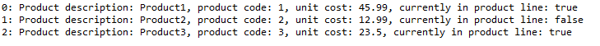
Print out the contents
Store
public String listProducts() { if (products.size() == 0) { return "No products"; } else { String listOfProducts = ""; for (int i = 0; i < products.size(); i++) { listOfProducts += i + ": " + products.get(i) + "\n"; } return listOfProducts; } }
Sample Output

Slide 28
Print out the contents
Store
If the size of the products ArrayList is zero,
return the String “No products” to the Driver class to be printed.
public String listProducts() { if (products.size() == 0) { return "No products"; } else { String listOfProducts = ""; for (int i = 0; i < products.size(); i++) { listOfProducts += i + ": " + products.get(i) + "\n"; } return listOfProducts; } }
Sample Output

Slide 29
Print out the contents
Store
public String listProducts() { if (products.size() == 0) { return "No products"; } else { String listOfProducts = ""; for (int i = 0; i < products.size(); i++) { listOfProducts += i + ": " + products.get(i) + "\n"; } return listOfProducts; } }
If there are products in the ArrayList…
return a String containing the index number of each product & the product details.
Sample Output

Slide 30
Methods (3)
Store
These methods work on the ArrayList to:
add Products
print out the contents
print out the cheapest product

Slide 31
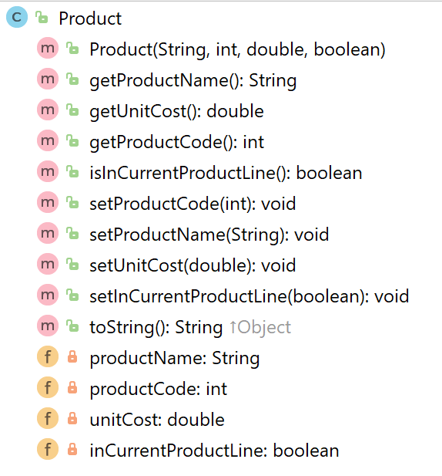
Finding the Cheapest Product
Product
getter
private field – unit cost

Slide 32
Finding the Cheapest Product Algorithm (numbered steps)
Store
If products have been added to the ArrayList
1.1 Assume that the first Product in the ArrayList is the cheapest (set a local variable to store this object).
1.2 For all product objects in the ArrayList
1.2.1 if the current product cost is lower than the cost of
the product object stored in the local variable,
1.2.1.1 update the local variable to hold the current product object.
end if
end for
1.3 Return the name of the cheapest product.
else
1.4 Return a message indicating that no products exist.
end if

Slide 33

Finding the Cheapest Product (step 1.)
Store
Working on the outer if statement (step 1.)
if products have been added to the ArrayList
return the cheapest product
else
return a message indicating that no products exist.
end if
Q: How do we write the code for this algorithm?

Slide 34

Store
if (products.size() != 0){
//return the cheapest product
}
else{
return “No products are in the ArrayList”;
}

Slide 35
Store
Another valid approach!
if (!products.isEmpty()){
//return the cheapest product
}
else{
return “No products are in the ArrayList”;
}

Slide 36
Working on step 1.1
Store
if products have been added to the ArrayList
// 1.1 Assume that the first Product in the ArrayList is the cheapest // (set a local variable to store this object).
else
return a message indicating that no products exist.
end if
Q: How do we write the code for this step?

Slide 37
step 1.1
Store
if (products.size() != 0){
Product cheapestProduct = products.get(0);
}
else{
return “No products are in the ArrayList”;
}

Slide 38
Working on the for loop step 1.2
Store
if products have been added to the ArrayList
// 1.1 Assume that the first Product in the ArrayList is the cheapest // (set a local variable to store this object).
// 1.2 For all product objects in the ArrayList
// determine the cheapest product
// end for
else
return a message indicating that no products exist.
end if
Q: How do we write the code for this step?

Slide 39
step 1.2
Store
if (products.size() > 0){
Product cheapestProduct = products.get(0);
for (Product product : products)
{
}
}
else{
return “No products are in the ArrayList”;
}

Slide 40
for each loop
Store
if (products.size() > 0){
Product cheapestProduct = products.get(0);
for (Product product : products)
{
}
}
else{
return “No products are in the ArrayList”;
}
Product: This is the type of object that is stored in the ArrayList.
product: This is the reference to the current object we are looking at in the ArrayList. As we iterate over each object in the ArrayList, this reference will change to point to the next object, and so on.
products: This is the ArrayList of Product.

Slide 41
step 1.2.1
Store
If products have been added to the ArrayList
1.1 Assume that the first Product in the ArrayList is the cheapest (set a local variable to store this object).
1.2 For all product objects in the ArrayList
1.2.1 if the current product cost is lower than the cost of
the product object stored in the local variable,
1.2.1.1 update the local variable to hold the current product object.
end if
end for
1.3 Return the name of the cheapest product.
else
1.4 Return a message indicating that no products exist.
end if
Q: How do we write the code for this step?

Slide 42
step 1.2.1
Store
if (products.size() > 0){
Product cheapestProduct = products.get(0);
for (Product product : products){
if (product.getUnitCost() < cheapestProduct.getUnitCost())
{
}
}
}
else
{
return “No products are in the ArrayList”;
}

Slide 43
Step 1.2.1.1
Store
If products have been added to the ArrayList
1.1 Assume that the first Product in the ArrayList is the cheapest (set a local variable to store this object).
1.2 For all product objects in the ArrayList
1.2.1 if the current product cost is lower than the cost of
the product object stored in the local variable,
1.2.1.1 update the local variable to hold the current product object.
end if
end for
1.3 Return the name of the cheapest product.
else
1.4 Return a message indicating that no products exist.
end if
Q: How do we write the code for this step?

Slide 44
Step 1.2.1.1
Store
if (products.size() > 0){
Product cheapestProduct = products.get(0);
for (Product product : products){
if (product.getUnitCost() < cheapestProduct.getUnitCost()){
cheapestProduct = product;
}
}
}
else{
return “No products are in the ArrayList”;
}

Slide 45
Working on the last step, 1.3
Store
If products have been added to the ArrayList
1.1 Assume that the first Product in the ArrayList is the cheapest (set a local variable to store this object).
1.2 For all product objects in the ArrayList
1.2.1 if the current product cost is lower than the cost of
the product object stored in the local variable,
1.2.1.1 update the local variable to hold the current product object.
end if
end for
1.3 Return the name of the cheapest product.
else
1.4 Return a message indicating that no products exist.
end if
Q: How do we write the code for this step?

Slide 46
step, 1.3
Store
if (products.size() > 0){
Product cheapestProduct = products.get(0);
for (Product product : products){
if (product.getUnitCost() < cheapestProduct.getUnitCost()){
cheapestProduct = product;
}
}
return cheapestProduct.getProductName();
}
else{
return “No products are in the ArrayList”;
}

Slide 47
Methods
Store
We have look at the following methods:
add Products
print out the contents
print out the cheapest product
There are other methods in Store that operate on the ArrayList. They have a similar approach to the methods above; we can look at these in labs if you wish.

Slide 48
driver
Refactor this class to handle a small change to the Store “interface”.

Slide 49
Store
Constructor
This was the only change to the public interface; we removed the parameter!

Slide 50
Previously our Shop used an array and we needed to know
how many Products to store:
Driver
store = new Store(numberProducts);
Now that we are using an ArrayList, we don’t need to set a capacity, so our constructor call becomes:
store = new Store();

Slide 51
Our output when we run V3.0 of the app:
Driver

Slide 52
V3.0 output:
No difference in output…we only changed the internal storage mechanism!
V2.2 output:

Slide 53
Collections
Allow an arbitrary number of objects to be stored.
Are implemented in Java’s Class libraries which contain tried-and-tested collection classes.
In Java’s class libraries are called packages.
We have used the ArrayList class from the java.util package.

Slide 54
ArrayList
Items may be added and removed.
Each item has an index.
Index values may change if items are removed (or further items added).
The main ArrayList methods are:
add()
get()
remove()
size()
ArrayList is a parameterized or generic type.

Slide 55

Questions?

